Slide 1
Full Stack Development Internship
By: Sneha Ravichandran

Slide 2
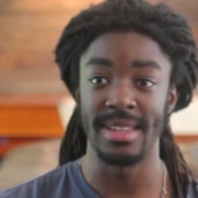
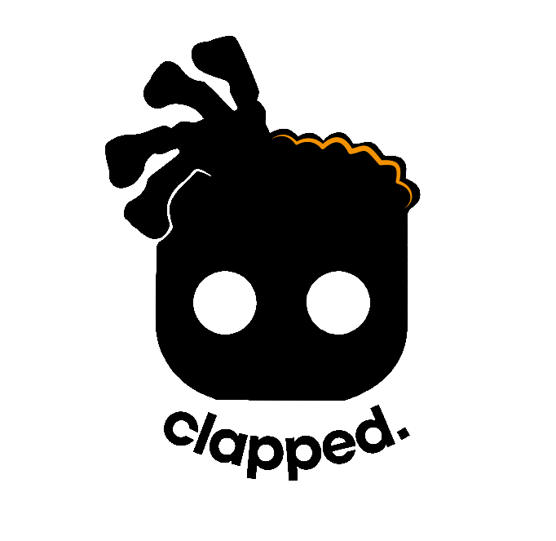
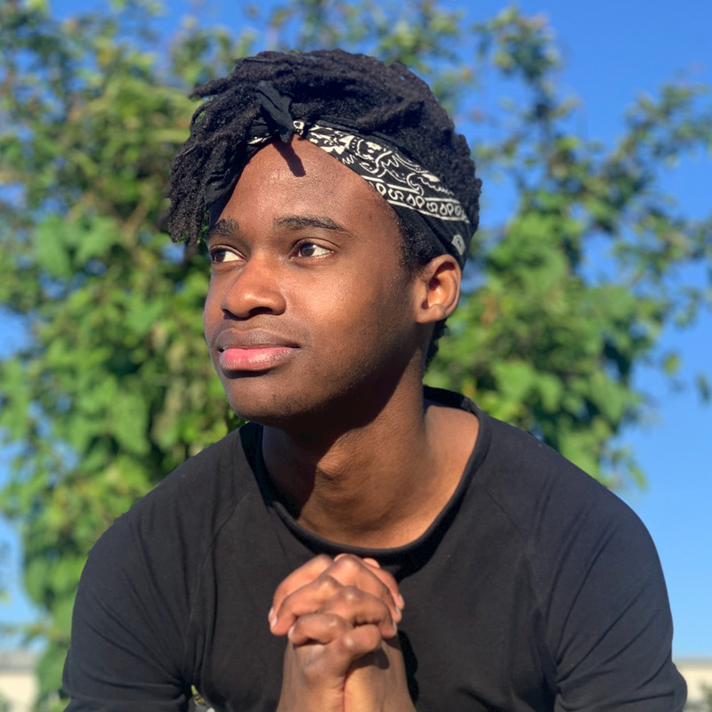
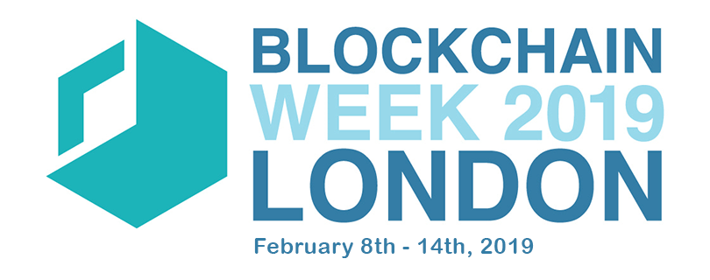
Intro
Edwin Melville-Green
Mdu Mtshali
Notes:
I got this internship from attending London Blockchain Week 2019 and meeting a developer named Edwin Melville Green who co-founded the startup, Clapped.

Slide 3




The Client and the Project
Machine Learning
Notes:
I started this project out with minimal requirements and a general idea from Eddie, and he shared with me some of the work he had been doing on the project. After more meetings with the clients to flesh out requirements of the web application we were finally ready to start the development process. I initially started learning Django from scratch since I hadn’t worked with it before, and before long after reading a lot of documentation and watching youtube videos I had a handle on it and started coding.

Slide 4






The Process - Backend
Used Django Framework for Backend
Why?
+
ORM
AUTHENTICATION
SECURITY
OBJECT-RELATIONAL MAPPING
TEMPLATES
FORMS
Notes:
I had little to no direction of exactly what the client wanted from this website and they weren’t technical so I had to use my skills from css 350, css 360, and css 370 to estimate the amount of work that was possible to complete and create my own requirements for the website

Slide 5


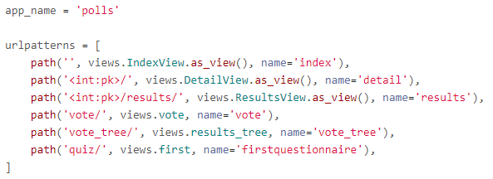
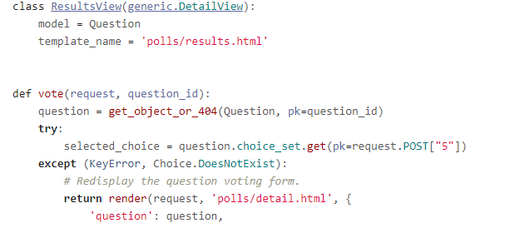
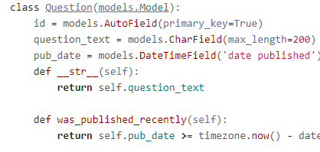
The Process - Backend
TEMPLATES
Interacts with the webpages to render view
BROWSER
URL S.PY
Matches URL with corresponding view
VIEWS.PY
Looks for appropriate models and templates
MODELS
Interacts with the model to send data back
Notes:
I had little to no direction of exactly what the client wanted from this website and they weren’t technical so I had to use my skills from css 350, css 360, and css 370 to estimate the amount of work that was possible to complete and create my own requirements for the website

Slide 6
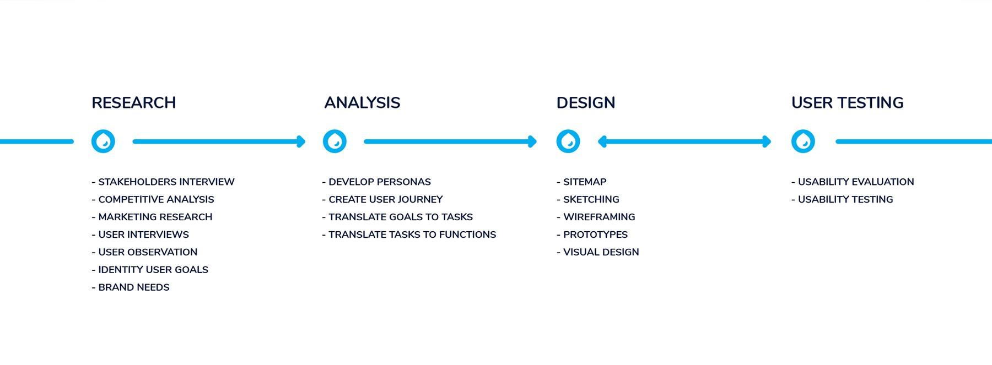
The Process – Design
Notes:
What did you learn? What do you wish you would have learned?
How did you enjoy what you're doing?
Was the mentoring handled well? Why or why not?
Cool things?

Slide 7
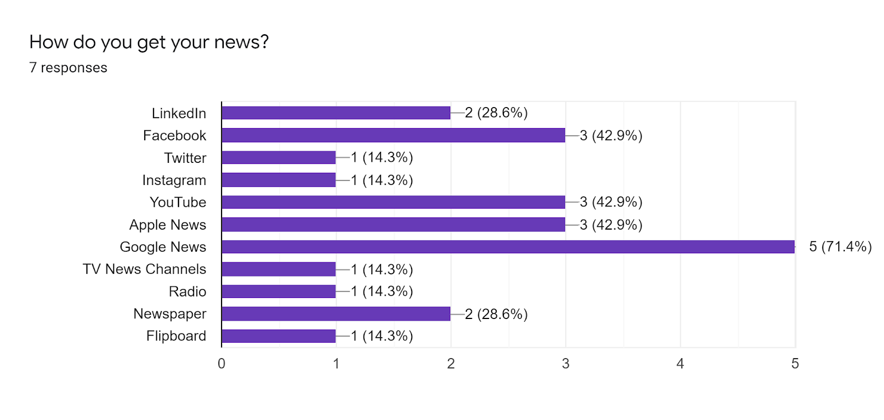
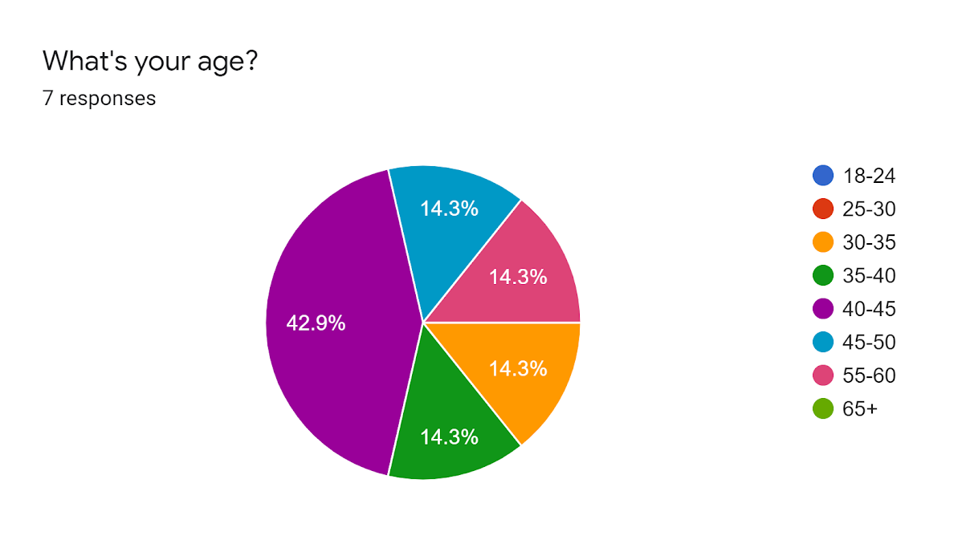
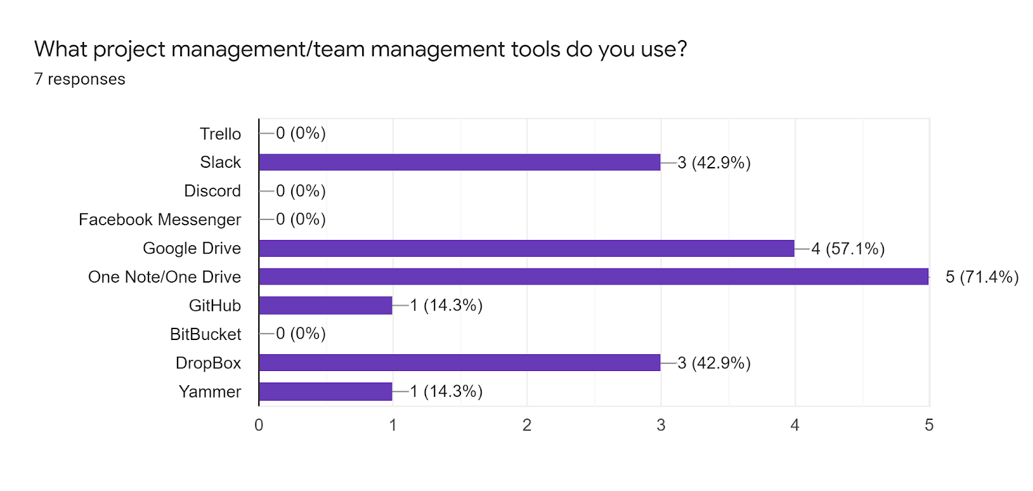
The Process – Research and Analysis
Notes:
Would you like to continue working at your internship company? Why or why not?
Yes I would like to continue working at my internship
They have offered me a full time position
Pros:
Good work environment
Good team
Good communication
Workers very open and complaint with others’ ideas

Slide 8
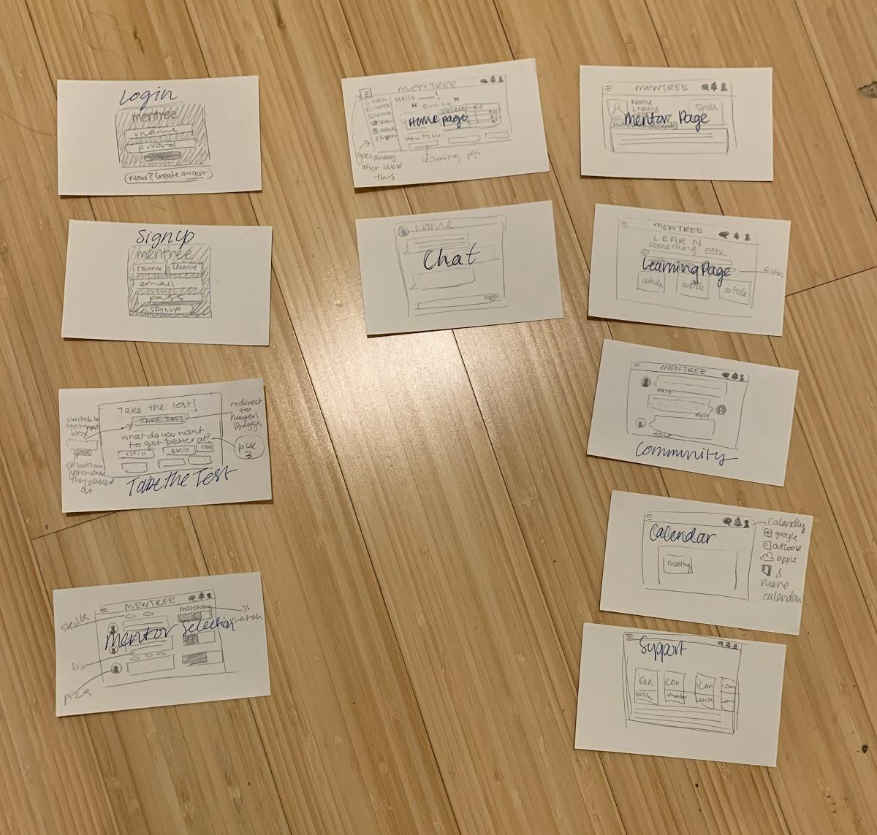
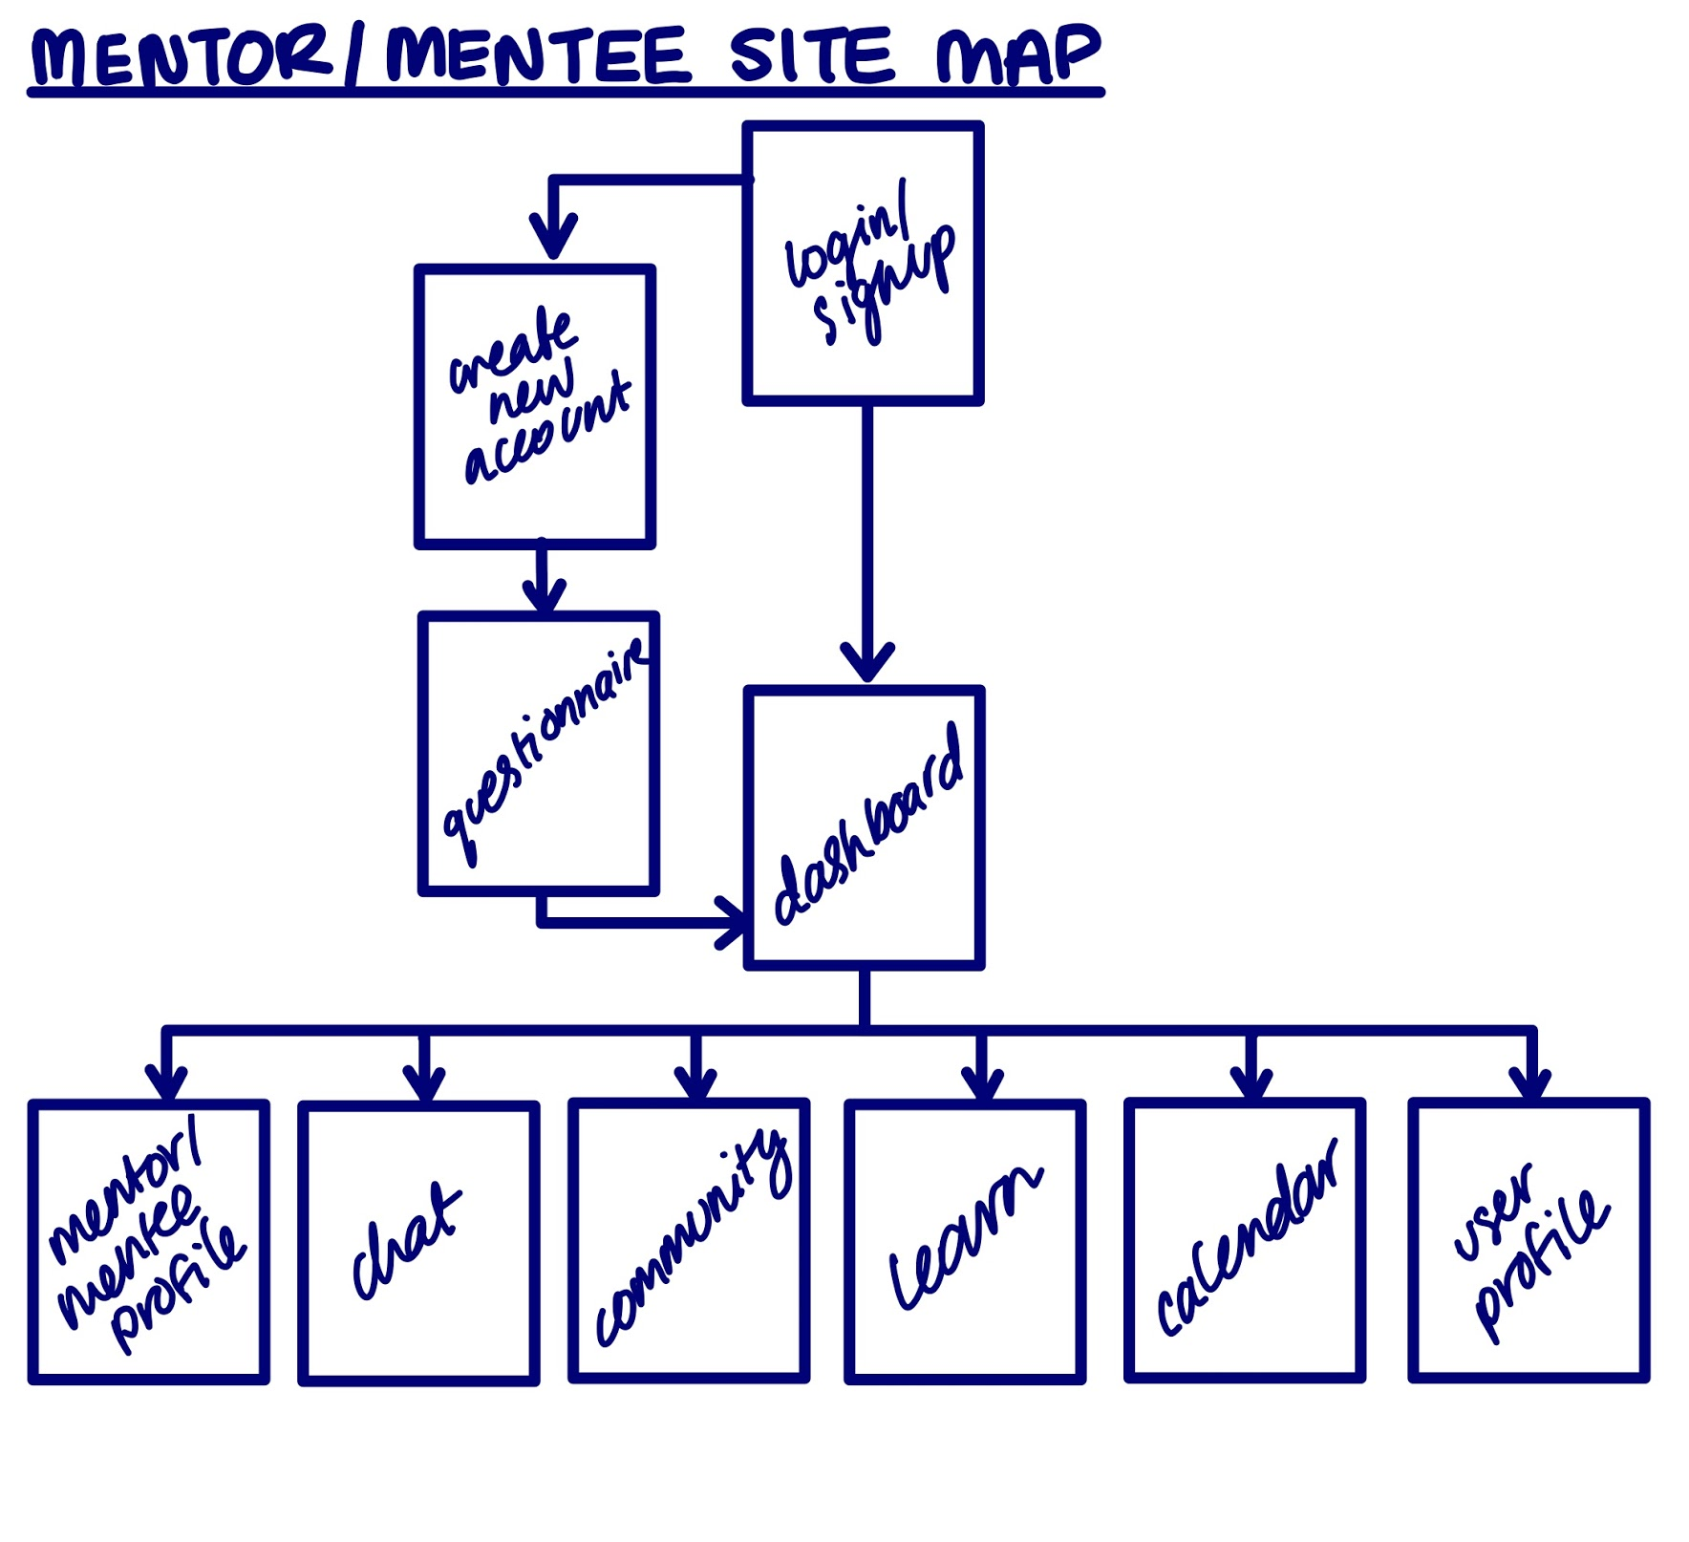
The Process – Design
Notes:
What did you learn? What do you wish you would have learned?
How did you enjoy what you're doing?
Was the mentoring handled well? Why or why not?
Cool things?

Slide 9
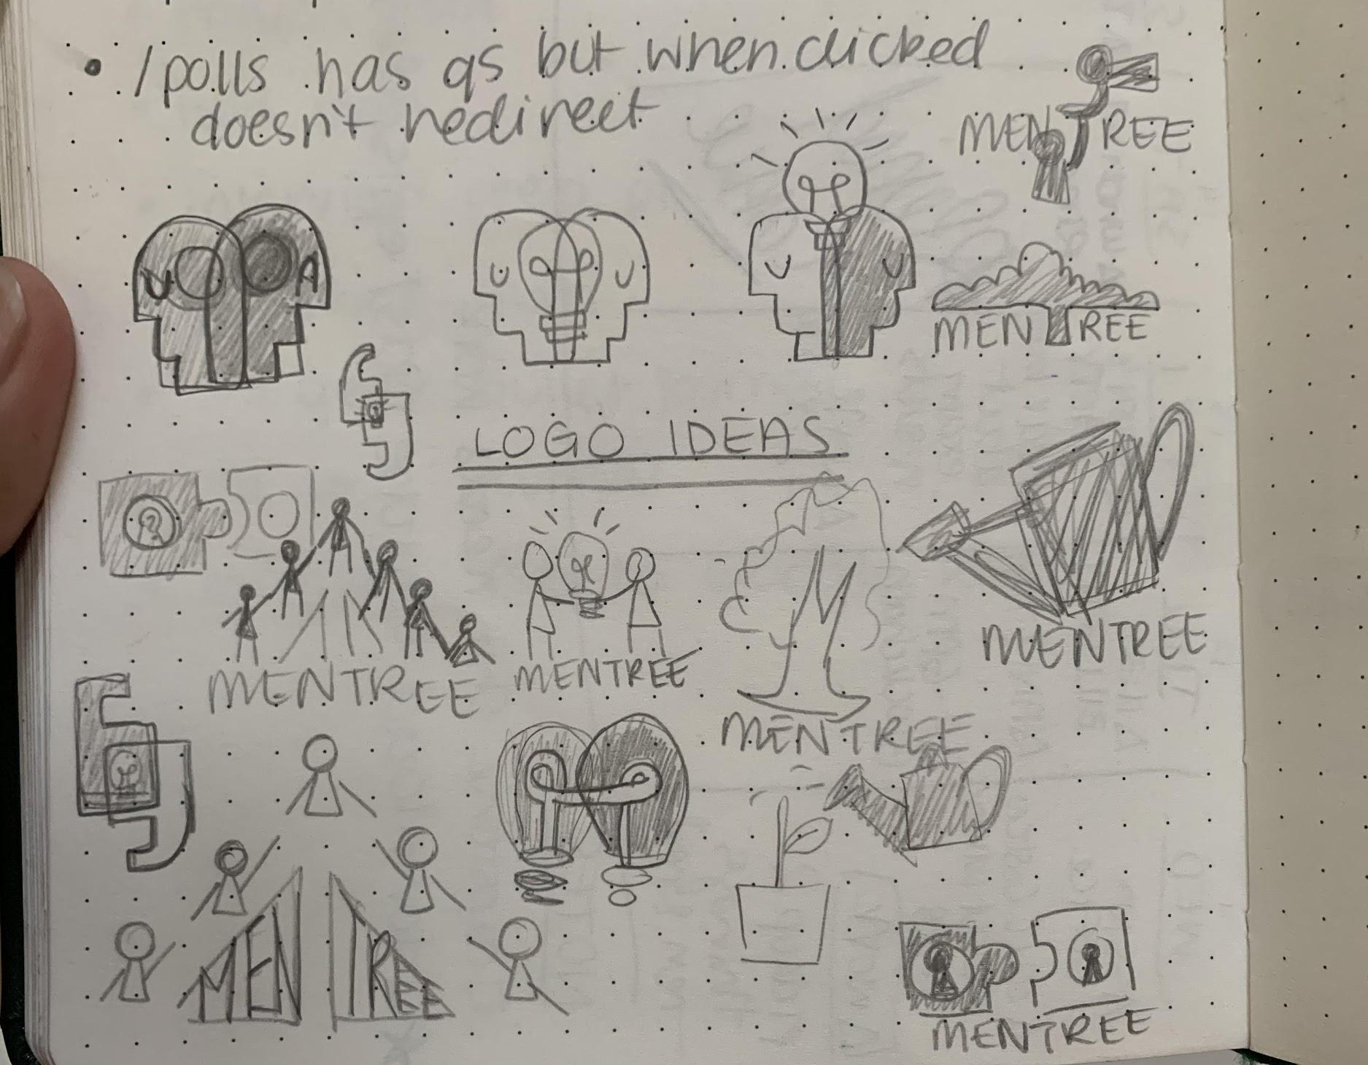





The Process – Logo Redesign
Sophia Umansky
Mia Ditmanson
Notes:
What did you learn? What do you wish you would have learned?
How did you enjoy what you're doing?
Was the mentoring handled well? Why or why not?
Cool things?

Slide 10
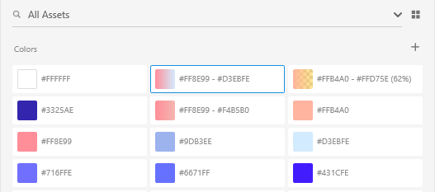
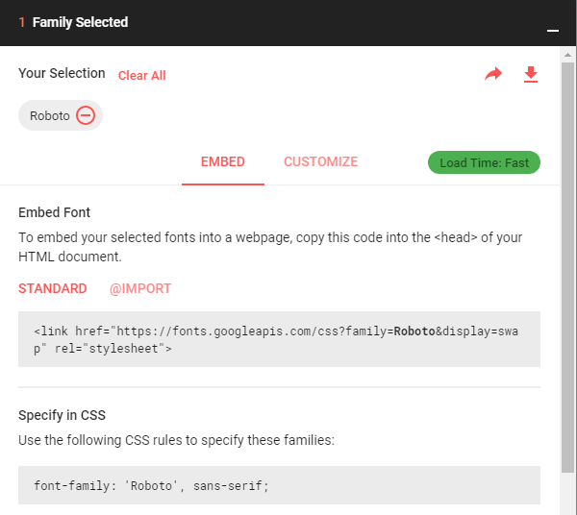


The Process – Color Schemes and Fonts
Dmitrii Kharchenko >
< Aryo Pamungkas
Notes:
I had little to no direction of exactly what the client wanted from this website and they weren’t technical so I had to use my skills from css 350, css 360, and css 370 to estimate the amount of work that was possible to complete and create my own requirements for the website

Slide 11
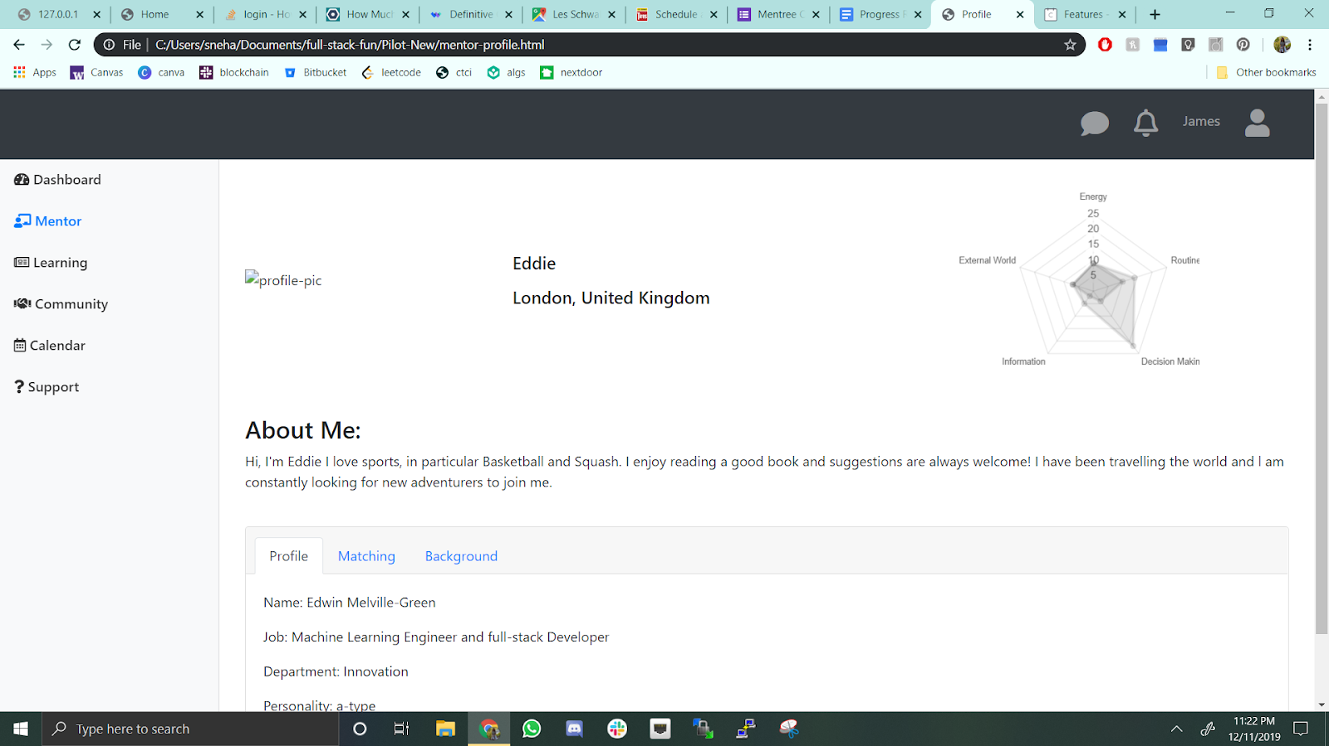
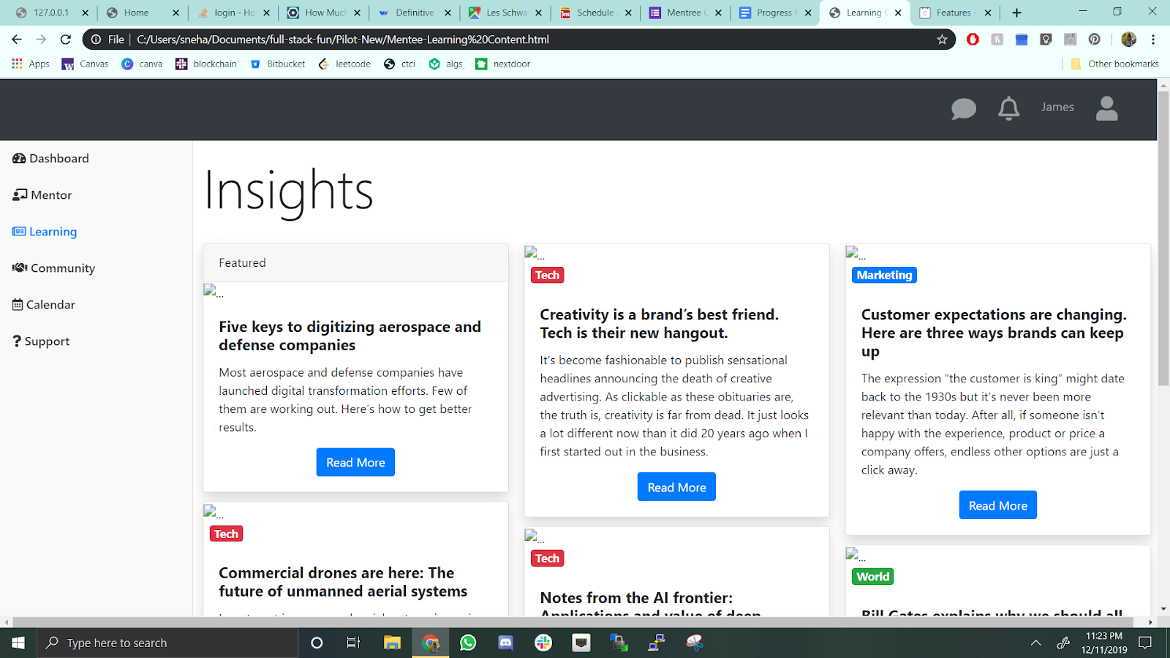
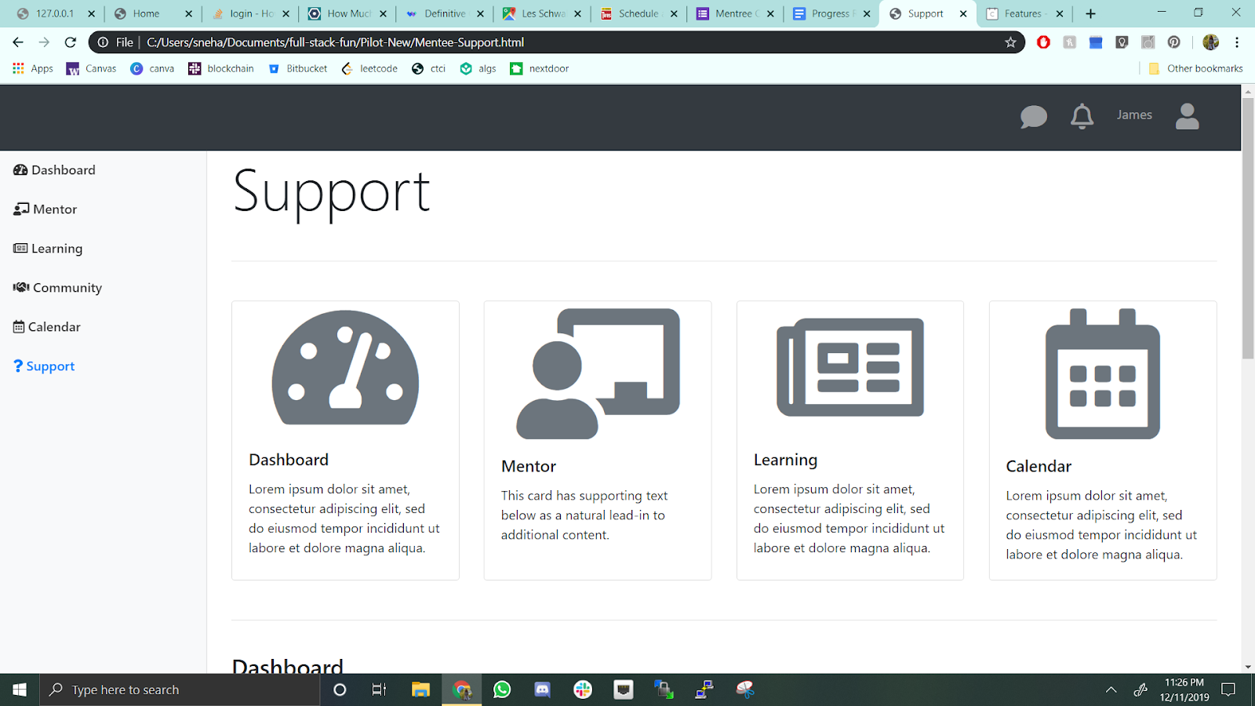
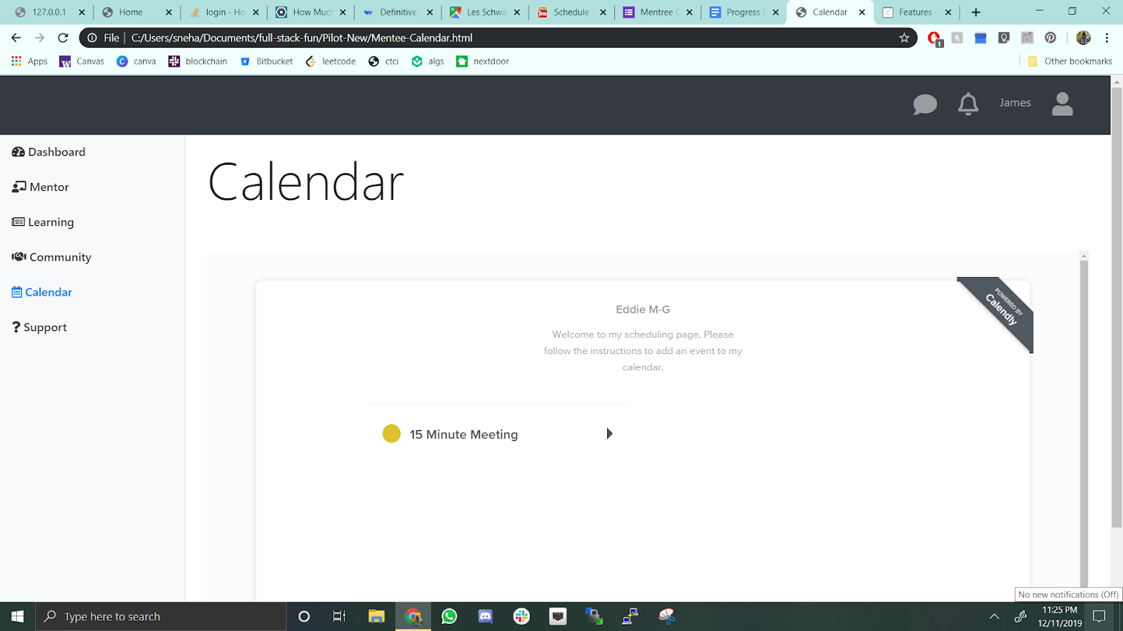
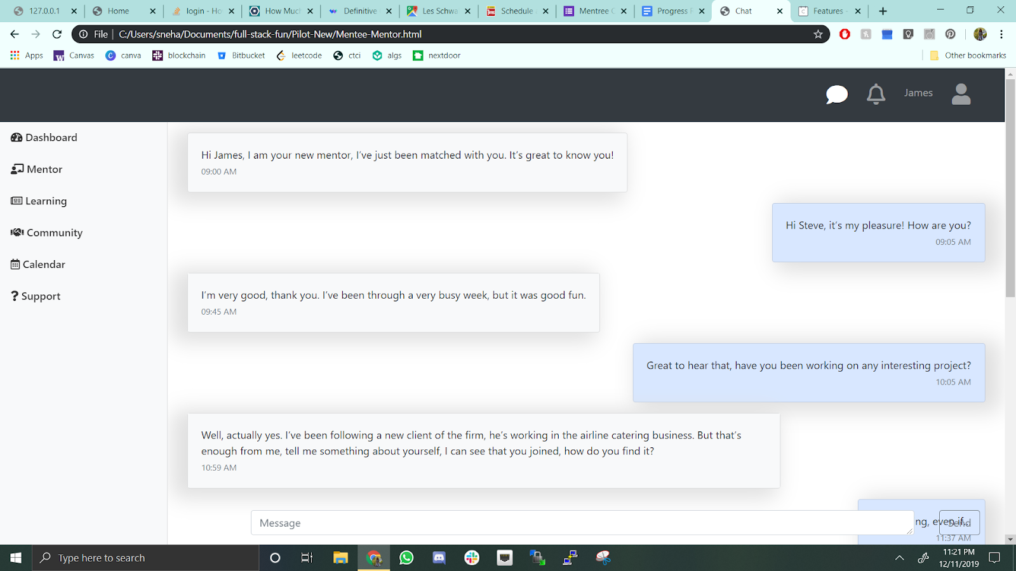
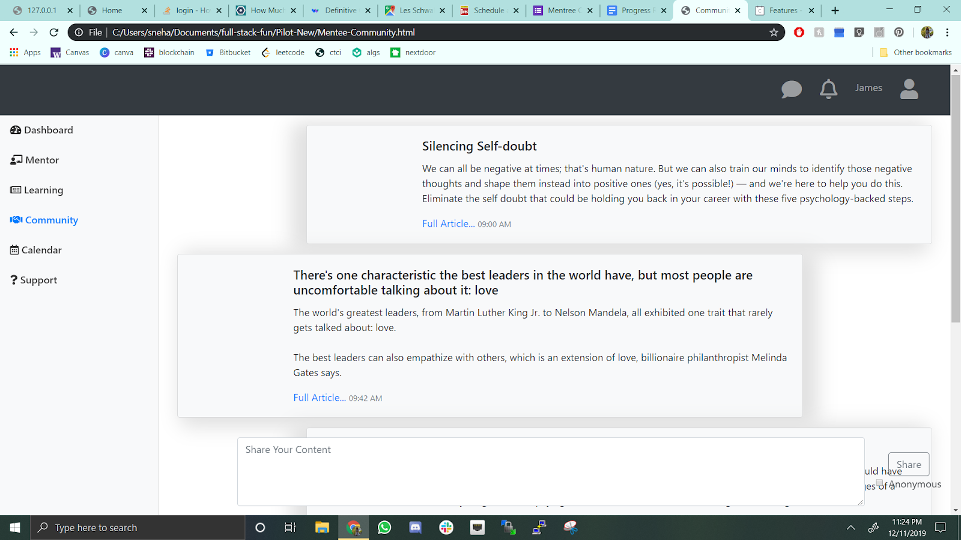
The Process – Basic Design Functionality Check

Slide 12
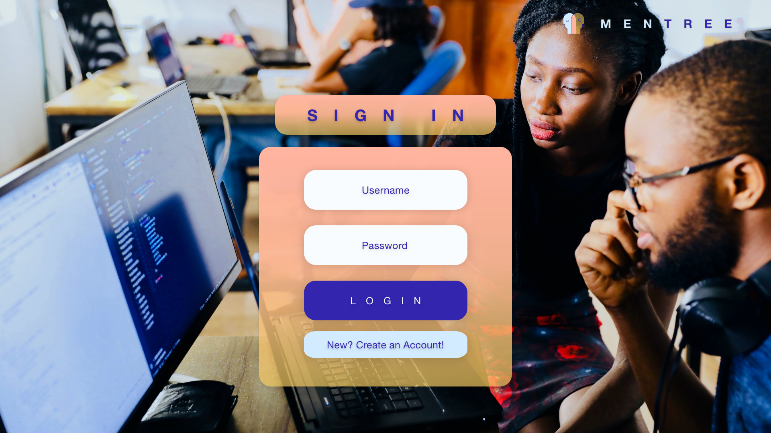
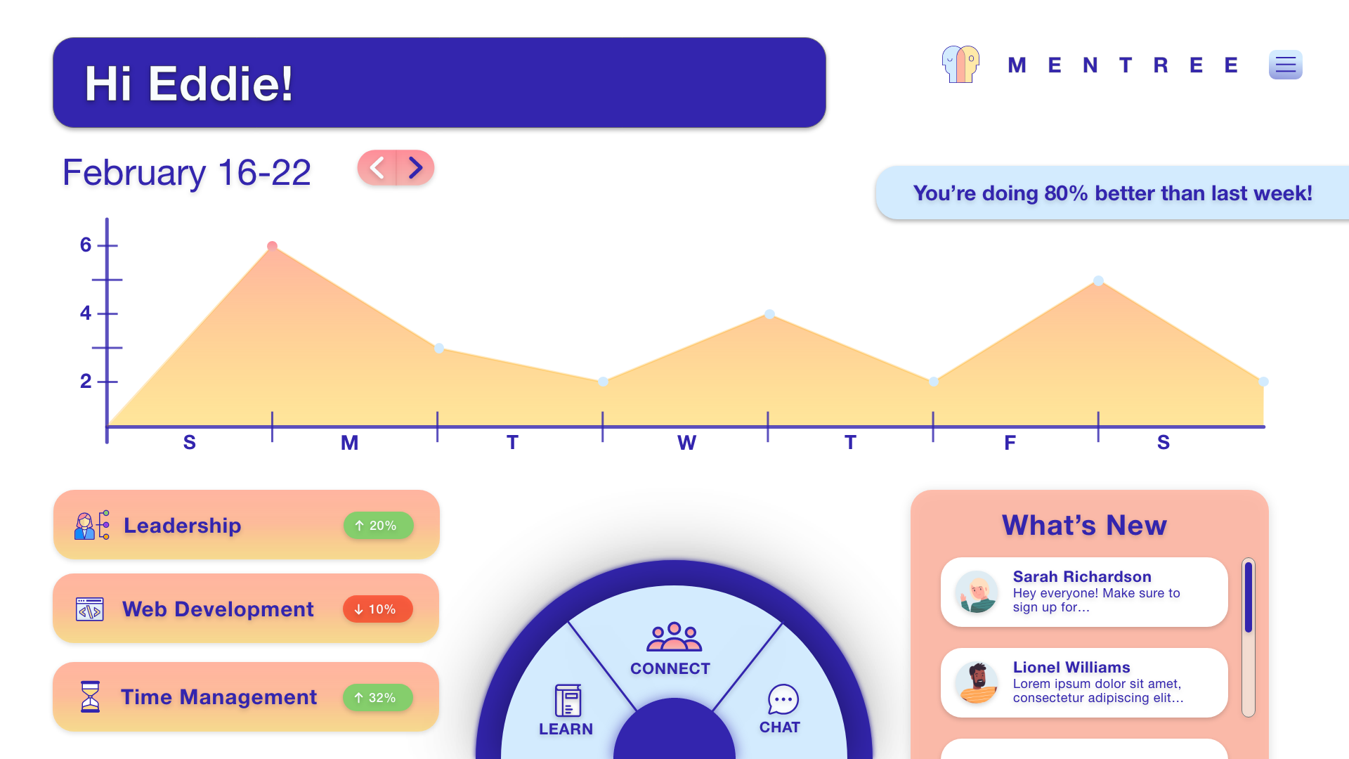
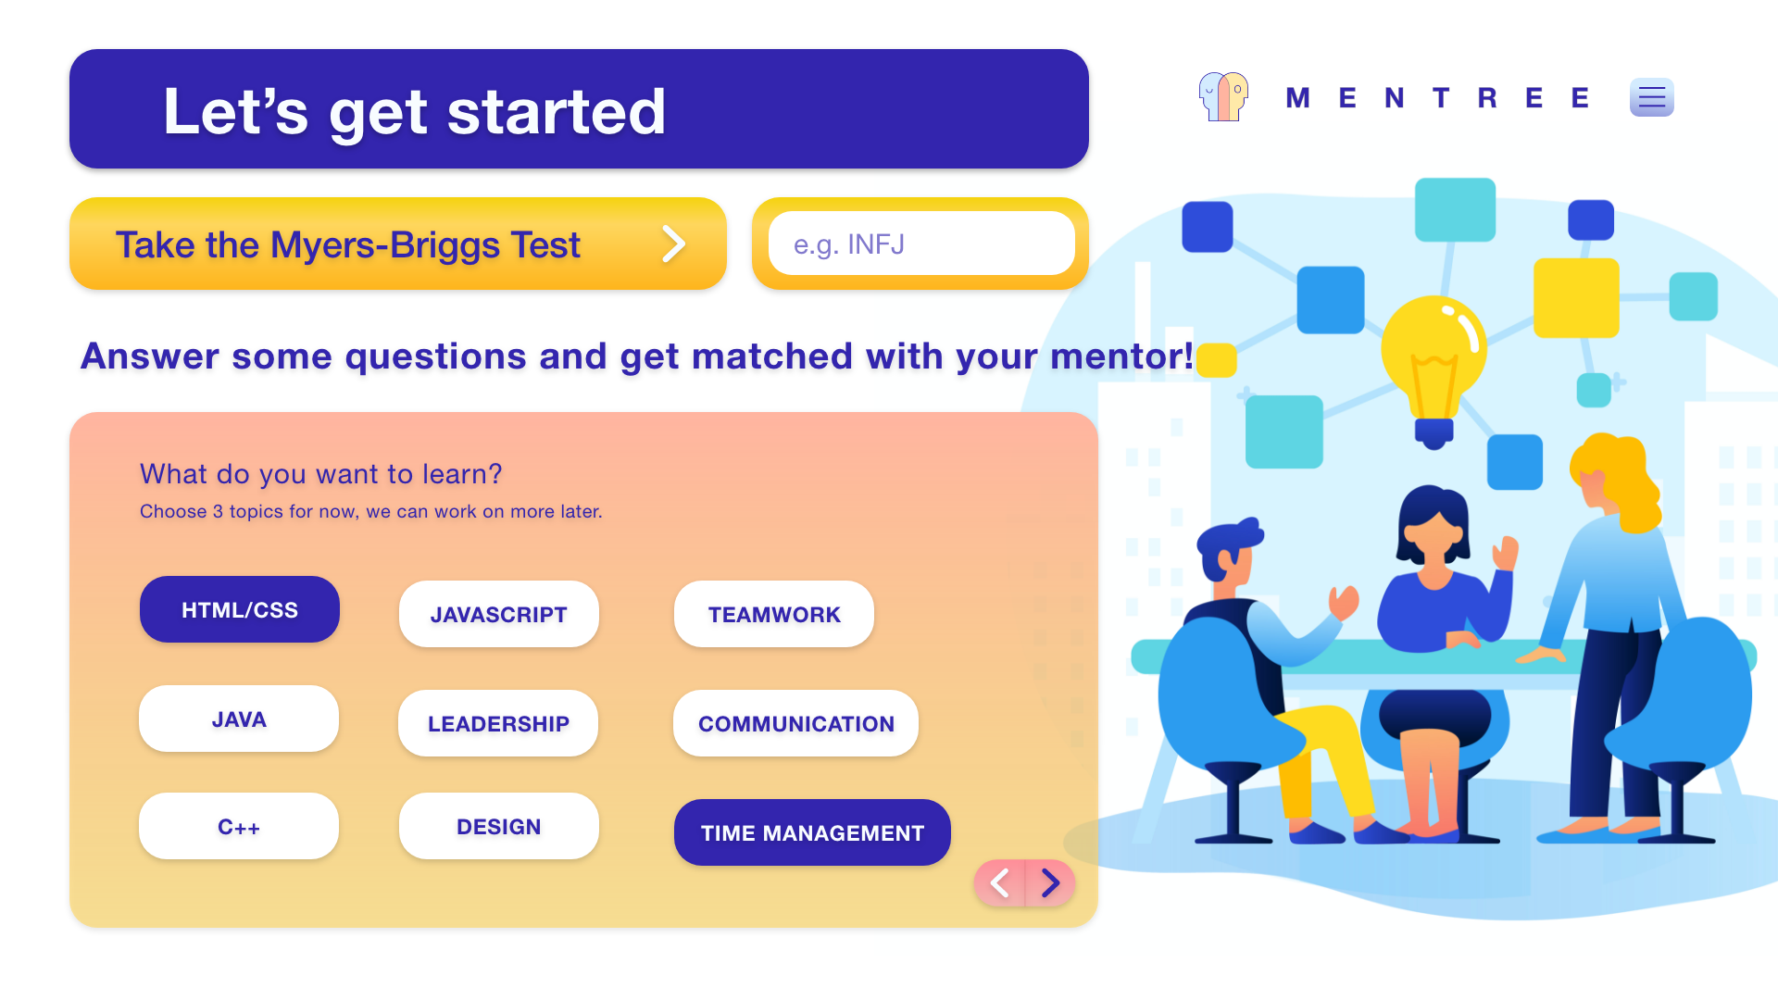
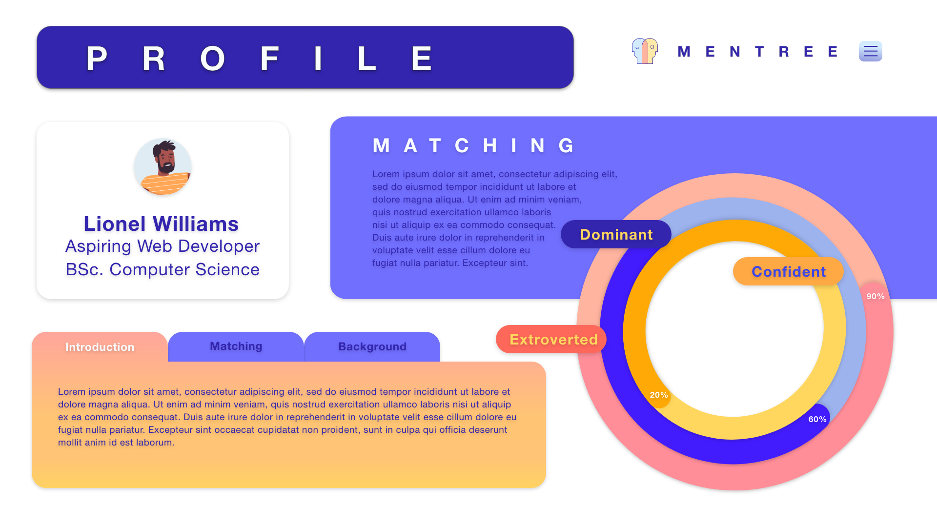
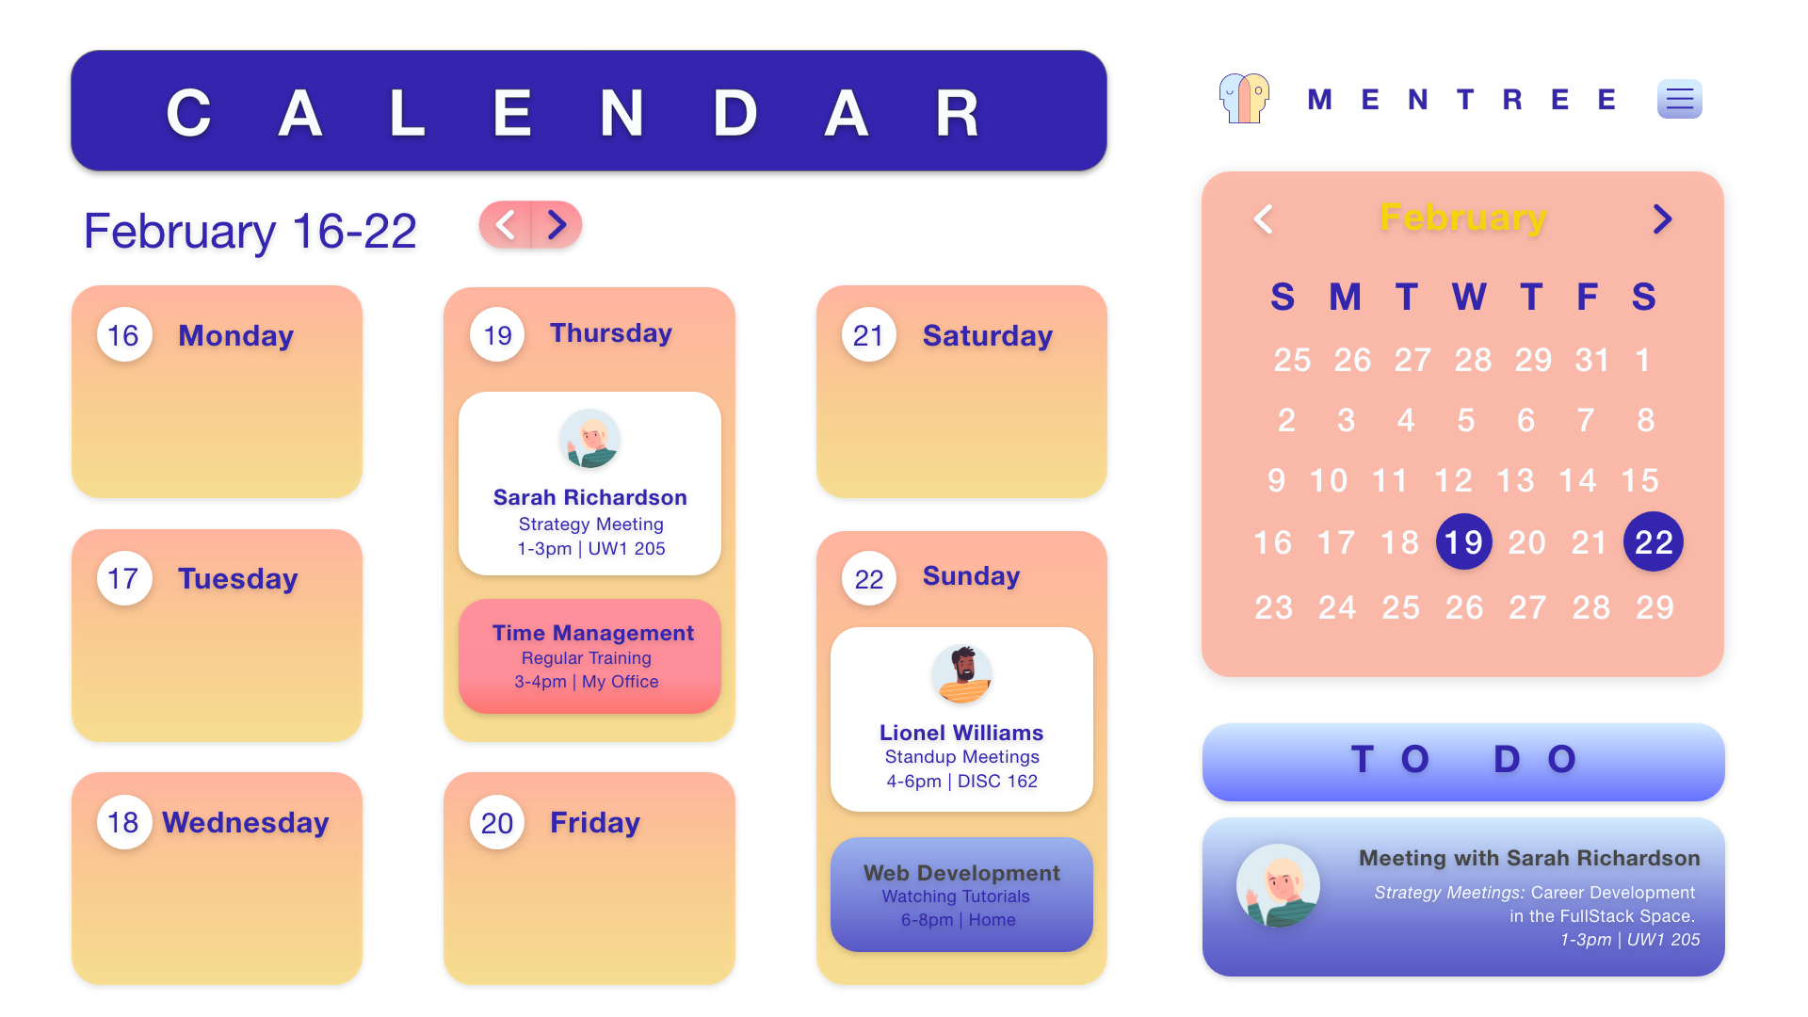
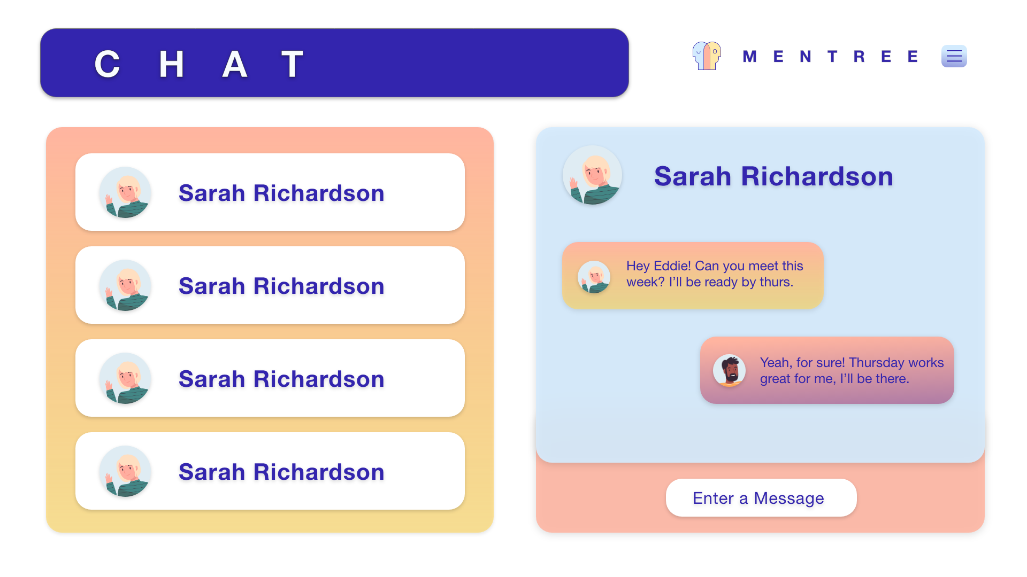
Results

Slide 13

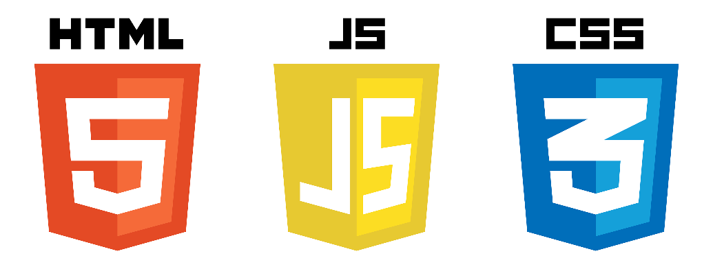
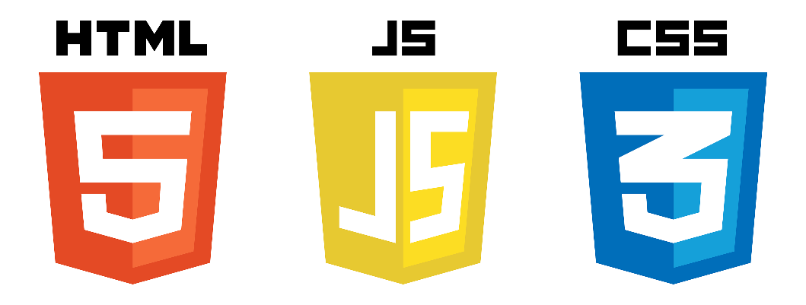








Tools Used
Backend Development
Frontend Development
Teamwork Tools
Notes:
I had little to no direction of exactly what the client wanted from this website and they weren’t technical so I had to use my skills from css 350, css 360, and css 370 to estimate the amount of work that was possible to complete and create my own requirements for the website

Slide 14
Relevant Coursework
CSS 360: Software Engineering
CSS 370: Analysis and Design
CSS 475 Databases
CSS 478: Usability and User Centered Design
CSS 342/343: Data Structures and Algorithms
Notes:
I started this project out with minimal requirements and a general idea from Eddie, and he shared with me some of the work he had been doing on the project. After more meetings with the clients to flesh out requirements of the web application we were finally ready to start the development process. I initially started learning Django from scratch since I hadn’t worked with it before, and before long after reading a lot of documentation and watching youtube videos I had a handle on it and started coding.

Slide 15
Challenges
Time Management
Communication
Learning through documentation
First time developing a big project independently
First time developing for a customer

Slide 16
Pros
Learned how to start a project from scratch
Enjoyed working with a small team
Best mentors I could ask for
I travelled to London and I’m hopefully going to more often!

Slide 17
Conclusion and Next Steps
Offered a full time role
I’m continuing to work with Clapped
Continuing to develop this project

Slide 18
Special Thanks to:
Bill Erdly, Eddie, and Mdu

Slide 19
Thank you
Questions?

Slide 20
